Slide 1
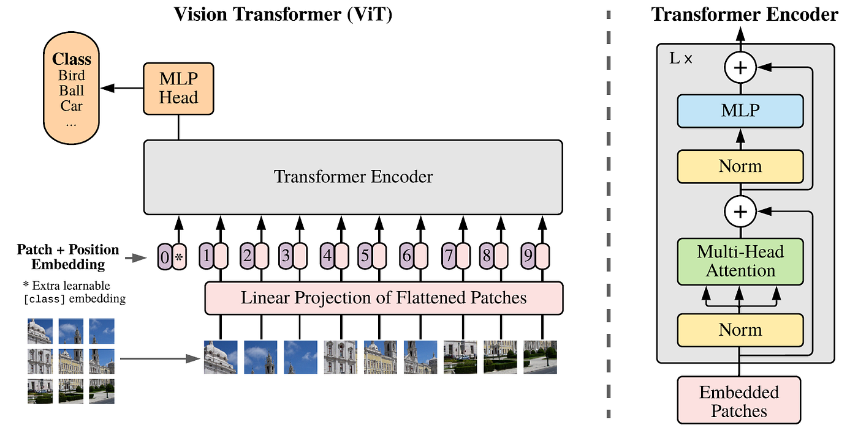
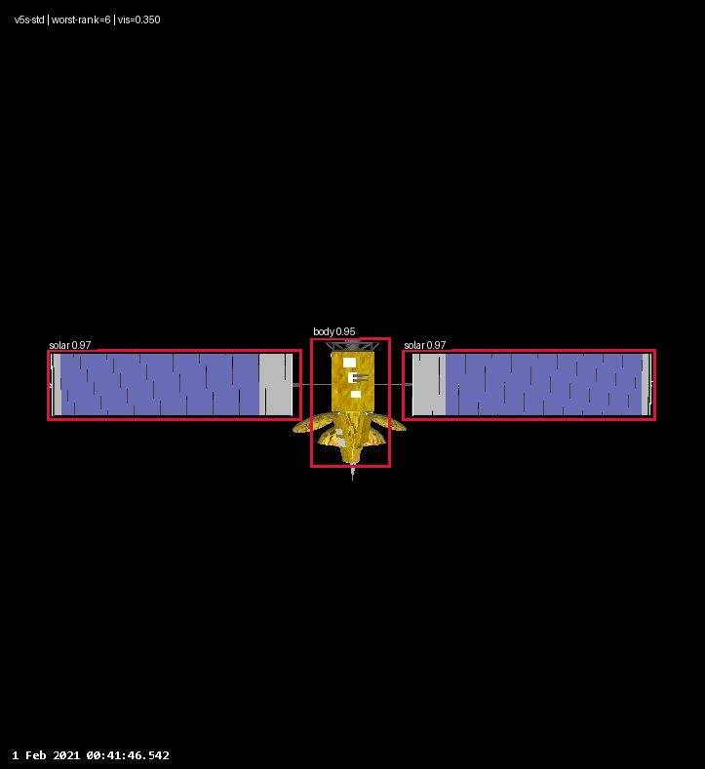
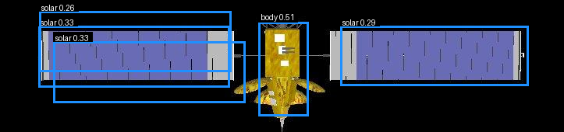
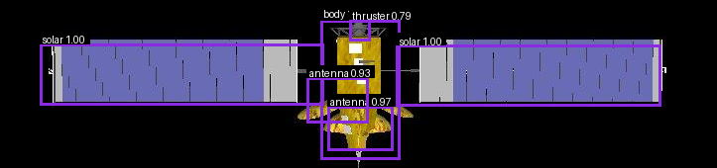
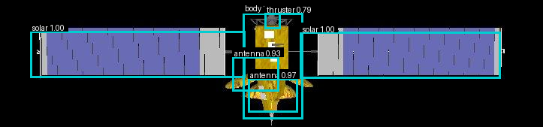
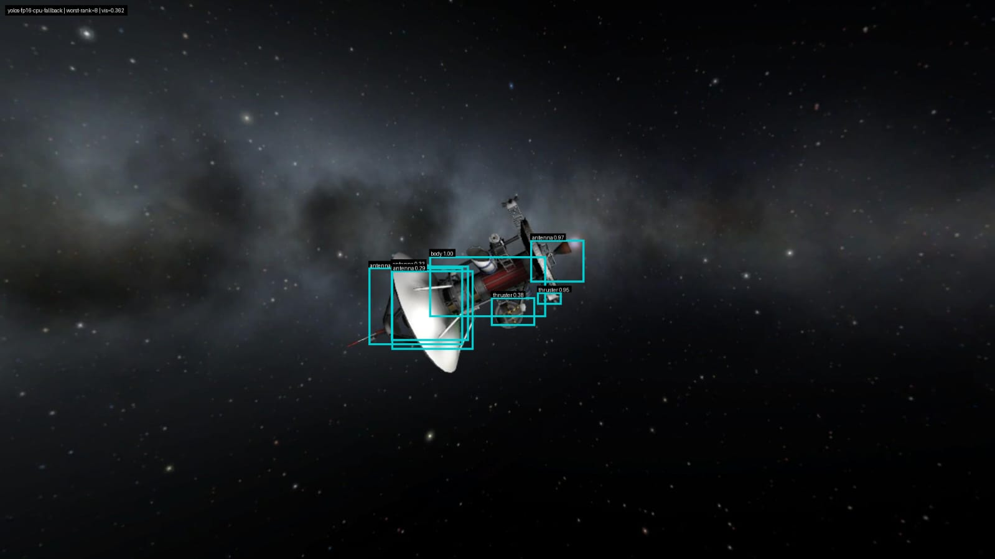
HALO: High Autonomous Low-SWaP Operations
Sloan Hatter, Blake Gisclair
Faculty Advisor: Dr. Ryan White, Dept. of Mathematics and Systems Engineering, Florida Institute of Technology
MOTIVATION
RESULTS
Orbital object detection is a vital aspect of space operations, particularly for identifying satellite components. Convolutional Neural Networks (CNNs) are typically used for such operations by running on-board models directly on satellite systems. However, a new neural network architecture, known as Vision Transformers (ViTs), have shown greater effectiveness due to their ability to capture global context. One main issue of deploying systems with such capabilities is resource allocation. One solution is to run models on a Low-SWaP system; however, this results in inefficient performance. To enable efficient ViT operations on Low-SWaP systems, the model must be scaled down through quantization, enabling the achievement of High Autonomous Low-SWaP Operations.
YOLOv5s | vis=0.350
YOLOv5s (Reduced) | vis=0.350
Model | mAP@0.5 | mAP@ [.50:.95] | GFLOPs | Model Size (MB) | Runtime Memory (MB) | FPS
YOLOv5s | 0.853 | 0.667 | 15.8 | 26.82 | 230.38 | 16.066
YOLOv5s (Reduced) | 0.701 | 0.491 | 10.4 | 14.24 | 184.93 | 12.9063
YOLOv5n | 0.808 | 0.57 | 4.1 | 6.75 | 111.31 | 10.8393
FP32 ViT | 0.848 | 0.53 | 18.6 | 24.69 | 288.74 | 6.3679
FP16 ViT | 0.848 | 0.577 | 18.6 | 12.34 | 144.37 | 1.249
YOLOv5n | vis=0.350
GOALS
Train types of CNN and ViT models
Quantize a ViT to FP16 representation
Quantize a ViT to INT8 representation
Evaluate & Compare CNN and ViT performance
FP32 ViT | vis=0.350
METHODS/RESOURCES
FP16 ViT | vis=0.350
NVIDIA TensorRT SDK
ONNX Quantization
Quantize/Dequantize (Q/DQ) Node Insertion
YOLOv5 Repository
NVIDIA Jetson AGX Orin
Dr. White’s NEural TransmissionS (NETS) Lab GPU servers
FUTURE WORK
REFERENCES
Achieve true 8-, 4-, 2-, and 1-bit representations of ViTs for orbital object detection tasks
Efficient satellite component object detection for:
Diagnosing broken components
Docking onto satellites
Identifying space debris
Further analysis of CNN vs ViT comparisions
Dosovitskiy, Alexey, et al. “An Image Is Worth 16x16 Words: Transformers for Image Recognition at Scale.” arXiv.Org, 3 June 2021.
Issitt, Arianna, et al. “Reliable onboard 3D reconstruction of unknown spacecraft via data acquisition guided by Orbital Geometry and lighting.” AIAA SCITECH 2026 Forum, 8 Jan. 2026.
Mahendrakar, Trupti, et al. “Unknown non-cooperative spacecraft characterization with lightweight convolutional neural networks.” Journal of Aerospace Information Systems, vol. 21, no. 5, May 2024, pp. 455–460.
Mukherjee, Shaoni. “Quantizing Vision Transformers for Efficient Deployment: Strategies and Best Practices.” Paperspace by DigitalOcean Blog, Paperspace by DigitalOcean Blog, 15 Dec. 2023.
NVIDIA. “Working with Quantized Types.” Working with Quantized Types - NVIDIA TensorRT, 7 Apr. 2026.
Ultralytics. “Comprehensive Guide to Ultralytics YOLOv5.” Ultralytics YOLO Docs, 7 Apr. 2026.
ACKNOWLEDGEMENTS
Dr. White, for his guidance and foundational research insights.
Arianna Issitt, for her help with the Jetson computer, datasets, and initial CNN model

